Slide 1
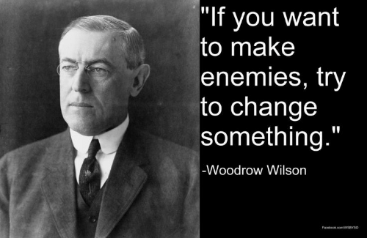
History Heroes
Term 2, Week 3

Slide 2
Question 1 (2 marks)
Who were the KKK?
(Write out name in full and give brief description of)

Slide 3
Question 2 (1 mark)
Who was Andrew Carnegie?

Slide 4
Question 3 (2 marks)
What years was Woodrow Wilson President?

Slide 5
Question 4 (1 mark)
What was the Manhattan Project?

Slide 6
Question 5 (1 mark)
What is capitalism?

Slide 7
ANSWERS

Slide 8
Question 1 (2 marks)
Who were the KKK?
A secret, white supremacist organisation founded in 1877, and was revived during the 1920s. The organisation used violence to intimidate African Americans, Catholics, foreigners, Jews and bootleggers.

Slide 9
Question 2 (1 mark)
Who was Andrew Carnegie?
A tycoon of the steel and iron industries in the late 1800s.

Slide 10
Question 3 (2 marks)
What years was Woodrow Wilson President?
1913-1921

Slide 11
Question 4 (1 mark)
What was the Manhattan Project?
A top-secret scientific program to develop an atomic weapon for use during WW2.

Slide 12
Question 5 (1 mark)
What is capitalism?
An economic and political system in which a country’s trade and industry are privately owned.

Slide 13
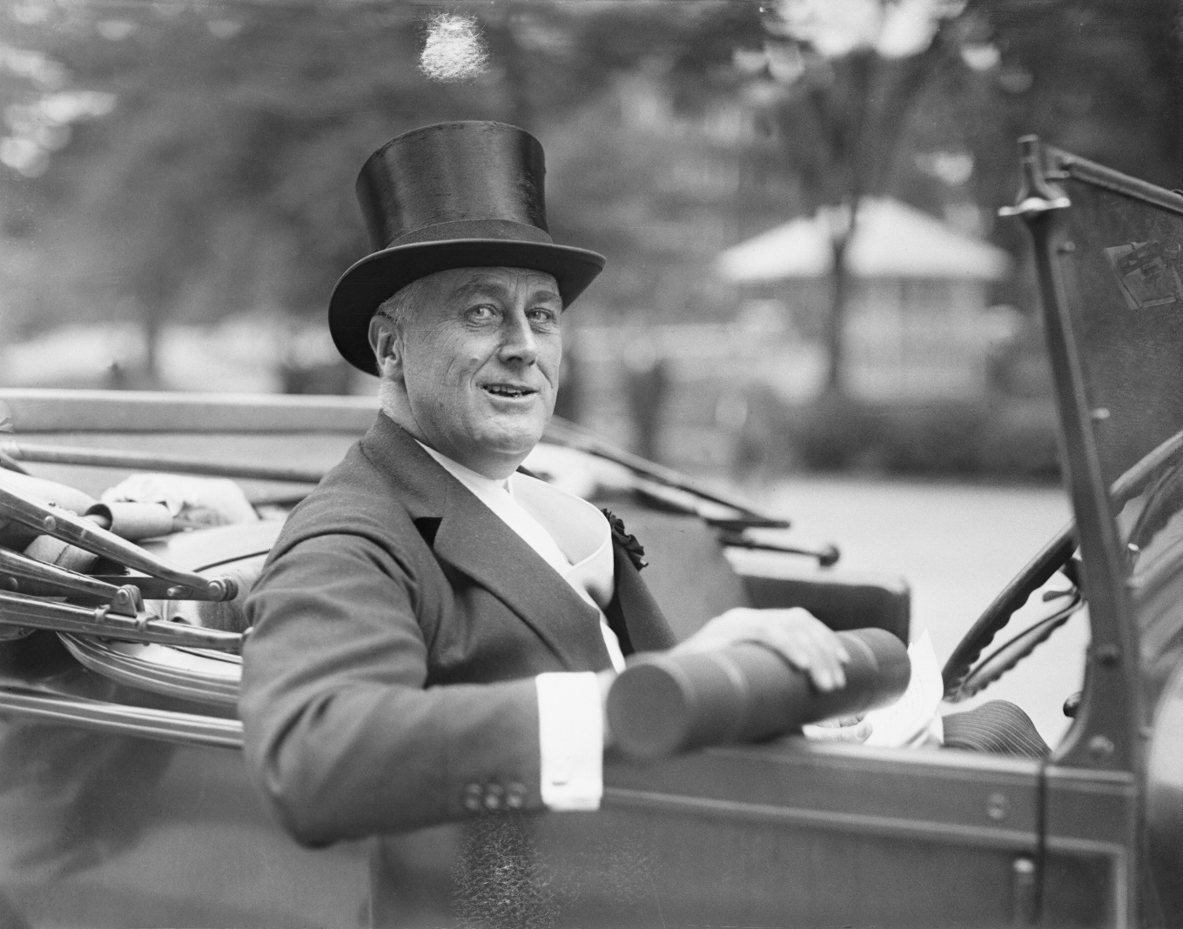
RESULTS??
/7

Slide 14
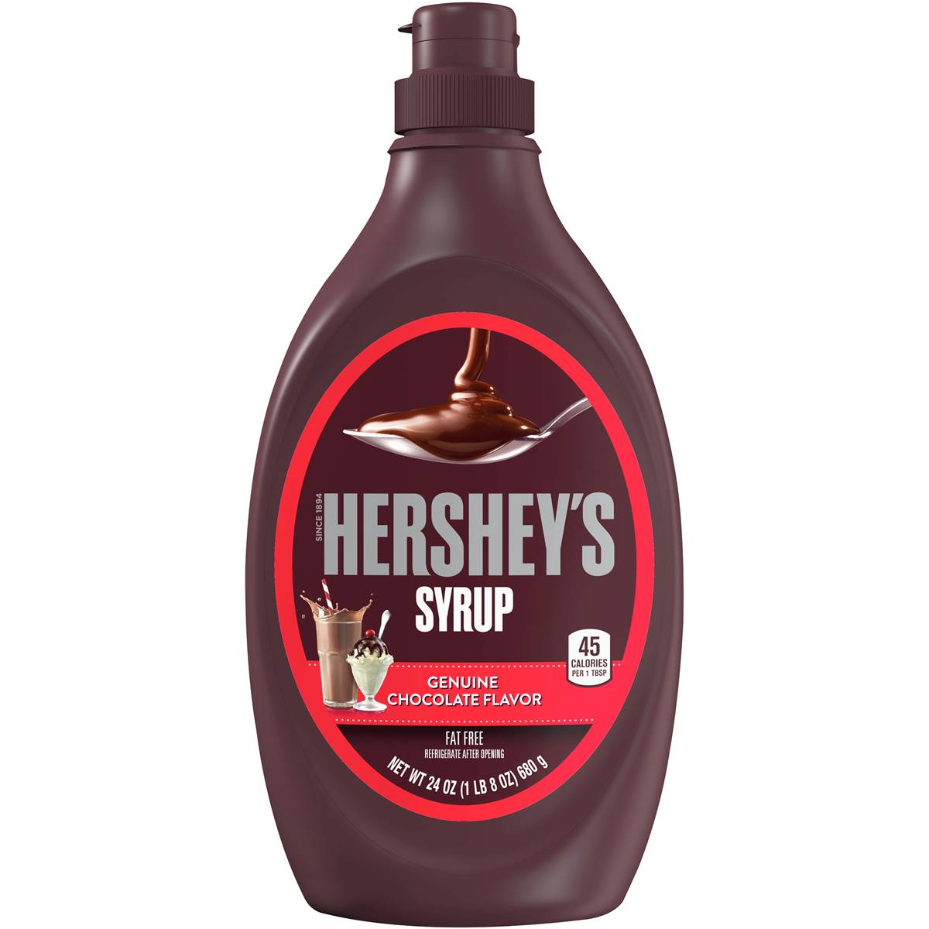
Source of the week

Slide 15
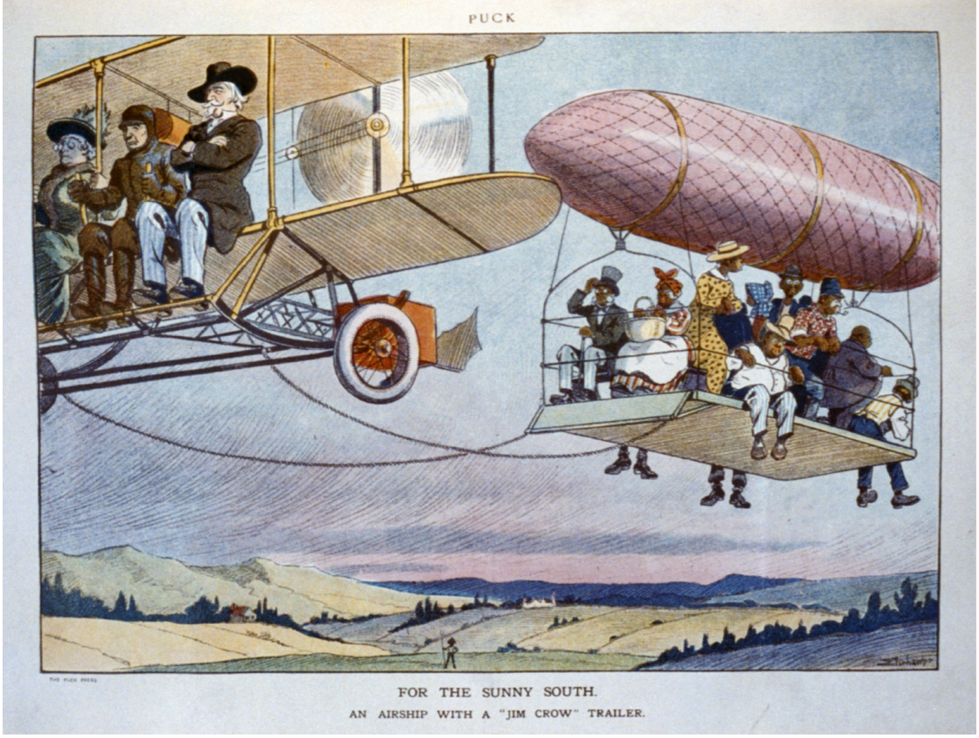
Title: For the sunny South. An airship with a "Jim Crow" trailer
Date Created/Published: 1913.

Slide 16
Jim Crow Laws
Laws enacted in the late 19th and early 20th centuries. State-based laws segregating white Americans and African Americans. The laws extended to education, housing, work, transport and sexual relations.

Slide 17
Cornell Notetaking

Slide 18
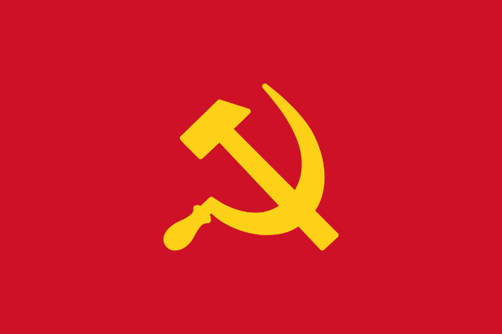

What is the difference between capitalism and communism?

Slide 19
Capitalism
Capitalism is an economic system in which the trade and industry of the economy is owned and controlled by private individuals, to make profit.
Based on the principle of individual rights.
Promotes class distinctions/divisions.
Democratic government.
The resources or the means of production lies with a private owner.
The profit in a capitalist structure belong to the private owner only.
Capitalism stands for private property.

Slide 20
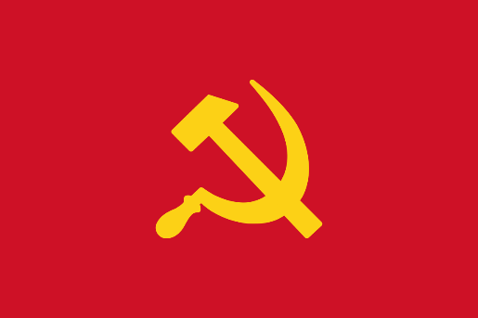
Communism
Communism refers to social system in which country's trade and industry are controlled by the community and the share of each individual relies on his ability and needs.
Based on the principle of community rights.
Promotes egalitarian society.
Totalitarian system of government.
The community or society solely owns the resources or the means of production.
The profit of any enterprise is equally shared by all the people in communism.
The society is above individuals.
Stands for abolishing private property.

